Slide 1


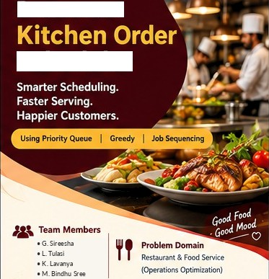
Restaurant
Scheduler

Slide 2
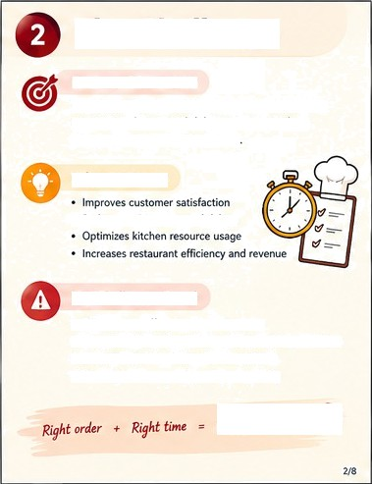

The Challenge
Sequence kitchen orders using preparation time, urgency and promised delivery time to reduce deleys and ensure timely deliver
deduces wafting tim and delays
Order hue diherent preparatia times
Some orders are u nt or love strict delideadlines
Limb kftcfien resources {chef stations)
Need O balance speed, valid and priority

Slide 3
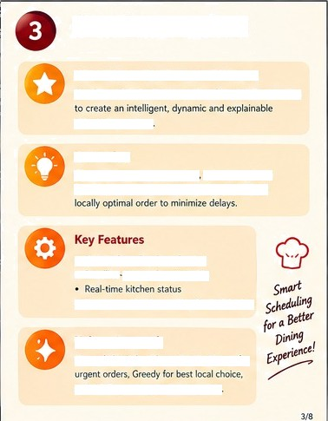

Give priority to urgant orders, schaduJa jobs in
feasible t'me sk•tt, and al' aye choose tt'e best
TranspHerK dec
& scheduled

Slide 4

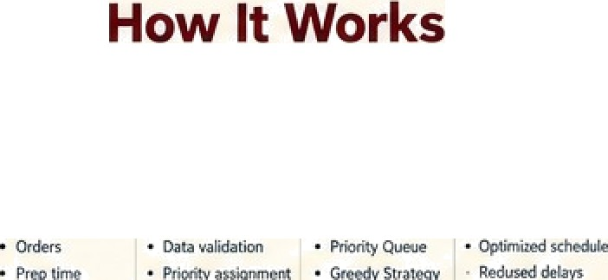

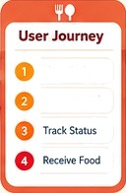

3. Al ihmo<œm$
OF ate p*smre4 - seaueace ad deleted on tone

Slide 5




Technology & Algorithm
(Ooiabaœ)
@ Main Algot4thms
Complexity

Slide 6
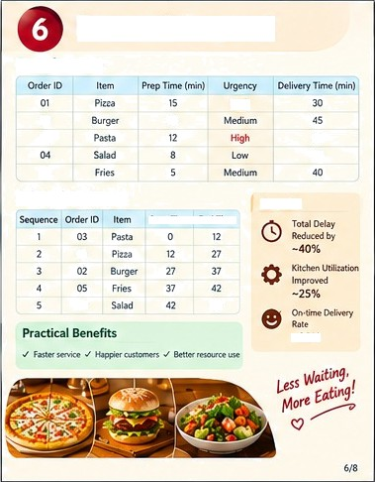
Demo & Impact
Sample Input

Slide 7
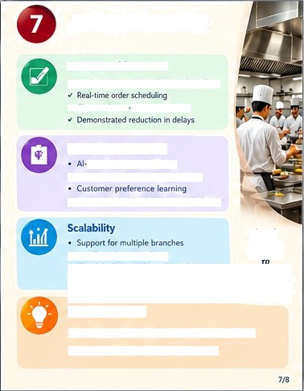


Future Vision
Count Achievement
based demand prediction
Dyntl When resoune eTlocafion
Integration will Fos 8 delivery @aAm
Hendle high order volume
Tec op * Smart Arms + Read-time Oata
- E@n•ient @gecs + happy Cvcomers

Slide 8
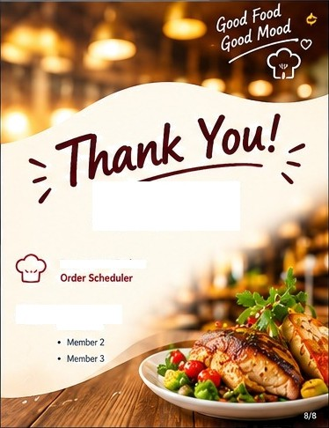

Restaurant Kitchen

